Slide 1



AWS Foundation
Database Services
Copyright IntelliPaat, All rights reserved
Notes:
Welcome back to the forth module of data science.

Slide 2
Agenda
1
What is a Database?
9
Pricing and designs
17
Demo
2
Types of Database
10
Demo
18
Pricing and designs
11
Aurora Introduction
19
What is AWS Redshift?
3
Databases on AWS
11
12
Benefits of Amazon Aurora
Advantages of Amazon Redshift
4
Introduction to RDS
20
Multi AZ Deployments
13
Pricing and designs
21
What is ElastiCache?
5
14
Demo: Aurora DB Cluster
22
Why AWS ElastiCache?
6
Features in Amazon RDS
15
Introduction to DynamoDB
23
Demo
7
Read replica
Core Components of DynamoDB
8
Reserved DB Instance
16
24
Quiz

Slide 3
What is a Database?

Slide 4
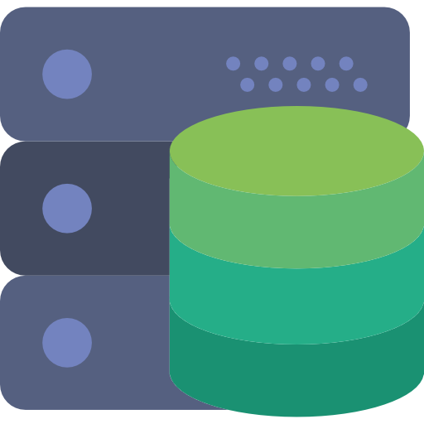


What is a Database?
Database is a collection of information which is organized so that the data or the information can be easily accessed, maintained and updated. The data in a database can be added, updated, expanded and deleted.
A software system created to perform all these operations on a Database is called Database management system or DBMS

Slide 5
Types of Database

Slide 6
Types of Database
There are several types of Databases that are categorized on the basis of various factors. Following is the list of most used and popular types of Databases which are categorized mainly on the basis of different ways of storing data in each database.
RDBMS
NoSQL Database
Hierarchical Database
Flat file database

Slide 7


Types of Database
In RDBMS the data is stored in tabular form and SQL (Structured Query Language) is used in RDBMS to run queries for inserting, updating, deleting and searching the data or records.
RDBMS
NoSQL Database
Hierarchical Database
Flat file database

Slide 8


Types of Database
NoSQL Databases don't follow the normal row/column or table approach of storing Data like RDBMS thus it’s a non relational database system. NoSQL Database store data in JSON format. The data structures included in NoSQL are key value, wide column, graph or documentations.
RDBMS
NoSQL Database
Hierarchical Database
Flat file database

Slide 9

Types of Database
Data is stored in a parent-children relationship nodes. Hierarchical database also contain the information of respective groups of data according to the parent/child relationships along with the data
RDBMS
NoSQL Database
Hierarchical Database
Flat file database

Slide 10

Types of Database
There are no particular structures for indexing and recognizing relationships between the data in Flat file database. All the records follow a uniform format and are saved in a file called flat file which can be a plain text file or even a binary file.
RDBMS
NoSQL Database
Hierarchical Database
Flat file database

Slide 11
Databases on AWS?

Slide 12
Database on AWS
Amazon Web Services (AWS) provides fully managed and purpose-built Database services to support the relational as well as non relational database requirements of their clients.
Following listed are Database services provided by AWS
Relational Database
Amazon RDS
Amazon Aurora
Key-value Database
Amazon Dynamo DB
In memory
Amazon Redshift
Amazon ElastiCashe

Slide 13
Introduction to RDS

Slide 14



Introduction to RDS
Amazon RDS (Relational Database Service) is used to set up, manage and scale a relational database instance in the cloud.
RDS is a fully managed RDBMS service.
Amazon RDS manages backups, software patching, failure detection and many more tasks.
With RDS, CPU, memory, storage and IOPS are all independent and hence can be scaled independently
RDS offers mainly six database engines, namely, Amazon Aurora, PostgreSQL, MySQL, MariaDB, Oracle Database, and SQL Server.

Slide 15
Multi AZ Deployments

Slide 16


Multi-AZ
Amazon RDS provisions as well as maintains synchronous a replica of DB Instances. This replica is termed as standby replica and the DB instance which gets synchronously replicated is termed as primary DB instance.
The primary DB instance is replicated to a standby replica in different availability zones.
Hence multi availability zones deployment provides:
Data redundancy
Elimination of I/O freezes
Less Latency spikes during system backups
Replication
AZ-1
AZ-2
Snapshot
Region

Slide 17
Features in Amazon RDS

Slide 18

Features in Amazon RDS
Various storage types in Amazon RDS such as general purpose storage and provisioned IOPS storage are designed to deliver consistent, fast and predictable I/O performance.
The compute and memory resources can be scaled up or down as per the deployment requirements. Scaling up can be done up to a maximum of 32 vCPUs and 244 GiB of RAM.
Performance and Scalability
High Availability
Security
Backup and Restore
Maintenance and Upgrades

Slide 19


Types of Database
Amazon RDS provides enhanced availability as well as failover support for database instances as a result of using Multi- AZ deployments.
Performance and Scalability
High Availability
Security
Backup and Restore
Maintenance and Upgrades

Slide 20

Types of Database
Amazon RDS allows to encrypt the database using the key that are managed by the users only. The automated backups, snapshots or read replicas of the encrypted data will also be encrypted.
Performance and Scalability
High Availability
Security
Backup and Restore
Maintenance and Upgrades

Slide 21

Types of Database
The feature of automated backup in Amazon RDS offers point in time recovery for the data of the database instance.
User initiated backups are also an option for backup in Amazon RDS. These are called Database snapshots
Performance and Scalability
High Availability
Security
Backup and Restore
Maintenance and Upgrades

Slide 22


Types of Database
RDS management console can be used to view key operational metrics such as computer, memory, storage capacity utilization, I/O activity and more.
Major engine version upgrades (changes might not be compatible with existing applications) and minor version upgrades ( backward-compatible with existing applications) can be performed.
Performance and Scalability
High Availability
Security
Backup and Restore
Maintenance and Upgrades

Slide 23
Read Replica

Slide 24


Read Replica
Read replica is an exact replica of the primary DB instance.
RDS uses DB engine’s inbuilt replication functionality to create these read replicas.
Replication happens asynchronously.
Read replicas can be created in same or different region. Automatic Backup has to be enabled.
PostgreSQL
MySQL
MariaDB

Slide 25
Read Replica
Amazon RDS does not support circular replication of DB instances. Creating Read Replica is different for all Amazon RDS DB engines, for example, read replica can be created from another read replica for MySQL and PostgreSQL whereas the same is not possible for Oracle DB engines.
Some other significant differences in read replicas of various RDS DB engines:
PostgreSQL | MySQL & MariaDB | Oracle
Physical Replication | Logical Replication | Physical Replication
Read Replicas cannot be made writeable | Read Replicas can become writeable | Read Replicas cannot be made writeable
Automated backups cannot be performed on PostgreSQL read replicas but manual snapshot can be created | Automated backups can be performed | Manual snapshots cannot be created in Oracle read replica, even the automatic backup cannot be enabled

Slide 26
Read Replica
db.r3.xlarge
GP2
db.m4.2xlarge
PIOPS
Source Storage Type | Replication Storage Type | Storage Size
PIOPS | PIOPS or GP2 or Standard | 100GB – 3TB
GP2 | PIOPS or GP2 or Standard | 100GB – 3TB
GP2 | GP2 or Standard | Less than 100GB
Standard | PIOPS or GP2 or Standard | 100GB – 3TB
Standard | GP2 or Standard | Less than 100GB

Slide 27
Reserved DB Instances

Slide 28
Reserved DB Instances
Amazon RDS offers the option to reserve a DB Instance for one or three year term for which the user gets a significant discount as compared to the On-demand Instant pricing for DB instance.
Features of Reserved DB Instances
There are three types of payment options available for Reserved Instances, namely, All Upfront, Partial Upfront, and No Upfront.
Reserved Instances can save up to an average of 69% over On- Demand Instances.
Reserved Instances are available in all of the AWS regions and for all supported DB engines.

Slide 29
Pricing and Designs

Slide 30
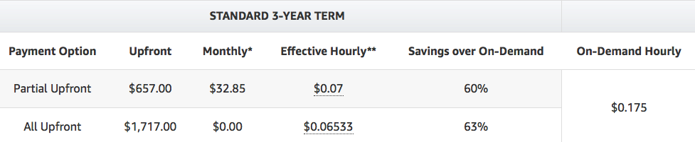
Pricing and Designs
On-Demand Instances
Single-AZ Deployments
Multi-AZ Deployments
Reserved Instances
db.m4.large
Storage
SSD (SAZ): $0.115 per GB/month
SSD (MAZ): $0.23 per GB/month
PIOPS (SAZ): Storage - $0.125 per GB/month, PIOPS Rate - $0.10 per IOPS/month
Magnetic (SAZ): Storage - $0.10 per GB/month, I/O Rate - $0.10 per 1M requests
Backup – FREE up to the size of active databases in a region. Additional storage is $0.095 per GB/month.
If there’s an active MySQL DB instance with 500 GB-month of provisioned database storage and an active PostgreSQL DB instance with 200 GB-month of provisioned database storage, up to 700 GB-month of backup storage will not have any charge.
Data Transfer charges (IN is free, OUT depends on where data is moving out)

Slide 31
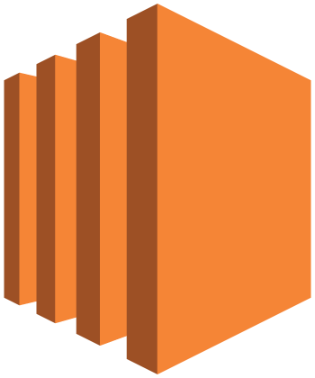
Pricing and Designs

Slide 32

RDS Design Patterns

Slide 33
Demo 1: DB Instance
Create subnet group for RDS VPC – aws-foundation-subnet-grp.
Create 2 security groups – one for Web Servers and another for DB instance which should allow access only from web servers.
Launch a MySQL DB instance: mysql-rds-db-instance.
Ignore backup setup as of now.
Modify a DB instance.
Connect to the DB instance from your machine.
Change database instance to use multi-AZ deployment.
Create another DB instance with Multi-AZ deployment.

Slide 34
Introduction to Amazon Aurora

Slide 35

Introduction to Amazon Aurora
Amazon Aurora is a relational database engine built for cloud and is completely compatible with MySQL and PostgreSQL.
Amazon Aurora is fully managed by Amazon RDS, which in turn automates administrative tasks such as database setup, patching, backups and more.

Slide 36
Benefits of Amazon Aurora

Slide 37
Benefits of Amazon Aurora
High Performance and scalability
Highly Secure
Provides 5X the throughput of standard MySQL and 3X the throughput of standard PostgreSQL
Provides multiple levels of security including encryption using user generated keys and network isolation using Amazon VPC.
High Availability and Durability
Fully managed
Offers greater than 99.99% availability and an option to backtrack to a previous point in time.
Amazon Aurora is fully managed by RDS and automates time consuming tasks such as hardware provisioning, software patching, setup, or backups.

Slide 38
Pricing

Slide 39
Pricing
DB Instance – pay as you go, price varies from one instance class to another.
Pricing for various Database Engines in N. Virginia region (DB Instance class – db.r3.xlarge, Multi-AZ deployment)
Reserved DB Instance.
For details visit https://aws.amazon.com/rds/pricing/
Database Engine | Price Per Hour | Storage Cost | I/O Cost
Amazon Aurora | $0.580 | $0.100/GB per month | $0.200 per 1 million requests
MySQL | $0.480 | $0.230/GB per month | $0.20 per IOPS-Month
MariaDB | $0.950 | $0.230/GB per month | $0.20 per IOPS-Month
Oracle (SE2) | $1.957 | $0.230/GB per month | $0.20 per IOPS-Month
PostgreSQL | $1.000 | $0.230/GB per month | $0.20 per IOPS-Month

Slide 40
Demo 1: Aurora DB Cluster
Create an Aurora DB instance and specify all the details.
Note the endpoint.
Create 1 Aurora replica.
How to create cross-region read replica.

Slide 41
Introduction to DynamoDB

Slide 42

Introduction to DynamoDB
DynamoDB is a fully managed NoSQL database. In DynamoDB no Database administration is required.
DynamoDB automatically spreads the data and traffic for tables over a sufficient number of servers to handle throughput and storage requirements.
JSON formatted documents can be stored as items in DynamoDB.

Slide 43
Core Components of DynamoDB

Slide 44
Core Components of DynamoDB
In DynamoDB, the collection of items is known as a table. A table in DynamoDB is not a structured table with fixed number of cells or columns.
Tables
Items
Attributes
Table

Slide 45
Core Components of DynamoDB
Each table in DynamoDB contains one or more than one items. Items are made up of group of attributes that are uniquely identifiable.
Tables
Items
Attributes
Items
Table

Slide 46
Core Components of DynamoDB
Attributes in DynamoDB are fundamental data elements or values that reside in item. Equivalent to data values that reside in a particular cell of a table in relational database.
Tables
Items
Attributes
Items
Attributes
Table

Slide 47
DynamoDB API
DynamoDB operations has to be done by provided APIs
CreateTable – Create a new table. Can be used to create indexes as well.
DescribeTable – Returns information about tables.
ListTables – Returns all tables.
UpdateTable - Modifies the settings of a table or its indexes, creates or remove new indexes on a table, or modifies DynamoDB Streams settings for a table.
DeleteTable – Removes table and its dependent objects.
PutItem – Writes a single item, primary key must be specified.
BatchWriteItem - Writes up to 25 items to a table.
GetItem – Retrieves a single item with Primary Key.
BatchGetItem – Retrieves up to 100 items from a table.
Query - Retrieves all of the items that have a specific partition key.
Scan - Retrieves all of the items in the specified table or index.
UpdateItem - Modifies one or more attributes in an item when Primary Key is provided.
DeleteItem – Deletes a single item with a specific Primary Key.

Slide 48
Pricing and Designs

Slide 49
DynamoDB Pricing (us-east-1)
Free Tier per month – 25 RCU, 25 WCU, 25 GB data storage, 2.5 Million Read Requests from DynamoDB streams. Free Tier does not expire.
RCU - $0.09 per RCU/month.
WCU - $0.47 per WCU/month.
Data Storage - $0.25 per GB/month.
Write per second = 10M/(24*60*60) = 115.7
WCU needed = 116
Write Cost = 116 X 0.47 = $54.52
Reads per second = 115.7
RCU needed = 116/2 = 58
RCU Cost = 58 X 0.09 = $5.22
Storage Cost = 200 X 0.25 = $50
Total Cost = 54.52 + 5.22 + 50 = $109.74
If FREE TIER not consumed = 42.77 + 2.97 + 43.75 = $89.49
Application Requirement:
10 million eventual consistent reads per day
10 million writes per day
200 GB of data
Max Item size is 1 KB

Slide 50
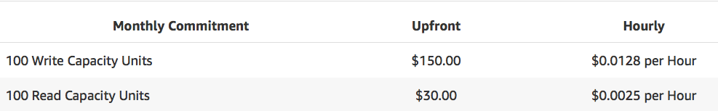
DynamoDB Pricing – Reserved Capacity
Min 100 RCU and WCUs.
Upfront Fee has to be paid.
Max for 1 year.
Data Transfer IN – Free
Data Transfer OUT within the same region – Free
Data Transfer OUT across other regions – Chargeable

Slide 51

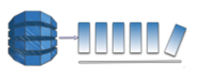
Design Patterns
Appl Program

Slide 52
What is Amazon Redshift?

Slide 53


What is Amazon Redshift
Amazon Redshift is a fully managed data warehouse service in the cloud. The data in Amazon redshift data warehouse can be scaled up to petabyte or more.
To create a database, a set of nodes called as Amazon Redshift Cluster has to be launched.

Slide 54
Advantages of Amazon Redshift

Slide 55

Advantages of Amazon Redshift
Even on large datasets, Amazon Redshifts delivers fast query performance. It also uses ML to predict incoming query runtime and assigns them optimal queue for fast processing.
Easy to setup, deploy and manage
It also provides performance boost when it comes to executing repeat queries by using result caching.
Faster Performance
Easy to setup, deploy and manage
Cost-effective
Secure

Slide 56



Advantages of Amazon Redshift
AWS provisions the infrastructure of the data warehouse automatically, making it simple and easy to create new data warehouse with just a few clicks in the AWS console.
It also automatically backs up the data in the data warehouse to the Amazon S3
Faster Performance
Easy to setup, deploy and manage
Cost-effective
Secure

Slide 57

Advantages of Amazon Redshift
Amazon Redshift is the most cost effective data warehouse where the user only has to pay for the resources they provision.
Redshift is the only cloud data warehouse offering On-Demand pricing and no up-front costs
Faster Performance
Easy to setup, deploy and manage
Cost-effective
Secure

Slide 58


Advantages of Amazon Redshift
Amazon redshift provides end to end encryption with just a couple of parameter settings. Amazon Redshift takes care of key management.
Amazon Redshift also enables users to configure firewall rules, providing full control over network access of the data warehouse cluster.
Faster Performance
Easy to setup, deploy and manage
Cost-effective
Secure

Slide 59
What is ElastiCache?

Slide 60

What is ElastiCache?
ElastiCache is a web service that provides high performance, cost-effective and scalable caching solution. It makes it easy to manage and scale a distributed in-memory data store or cache environment in the cloud itself.

Slide 61
Why AWS ElastiCache?

Slide 62
Why AWS ElastiCache?
Response time
Scalability
Using ElastiCashe improves the load and response time by allowing to retrieve data from a fast in-memory system, eliminating the dependence on slower disk based databases.
AWS ElastiCache is designed to be able to automatically modify itself to scale out or scale in as per the fluctuating application requirements.
Complete Management
AWS ElastiCache can also automate common administrative tasks such as hardware provisioning, failure recovery, backups, software patching and more.

Slide 63
Demo

Slide 64
Quiz

Slide 65
Quiz
1. Memcached clusters are comprised of up to how many nodes?
A. 10
B. 20
C. 6
D. 5

Slide 66
Quiz
2. Single Redis shard conﬁguration groups can have how many nodes in a single cluster?
A. 10
B. 20
C. 6
D. 5

Slide 67
Quiz
3. Can we rename cluster in Redshift?
A. Yes
B. No

Slide 68
Quiz
4. Redshift achieves extremely fast query execution by using Columnar data storage?
A. Yes
B. No

Slide 69

India : +91-7847955955
US : 1-800-216-8930 (TOLL FREE)
support@intellipaat.com
24X7 Chat with our Course Advisor
Notes:
Thank you!

